Slide 1
Fitness for All
The Benefits of Fitness

Slide 2
Fitness and Health
The word health is often associated only with physical fitness, but there are other components of health.
FITNESS means “readiness”. Fit people are better equipped than non-fit people.
The level of fitness includes all aspects of health and life.
It affects physical, mental, and social health.

Slide 3
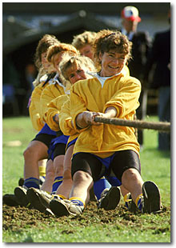
What is Physical Fitness?
Physical Fitness is the ability of your body systems to work efficiently. A fit person is able to carry out the typical activities of living, such as work, and still have enough energy and vigor to respond to emergency situations and to enjoy leisure time activities.

Slide 4
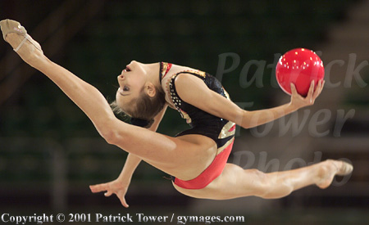
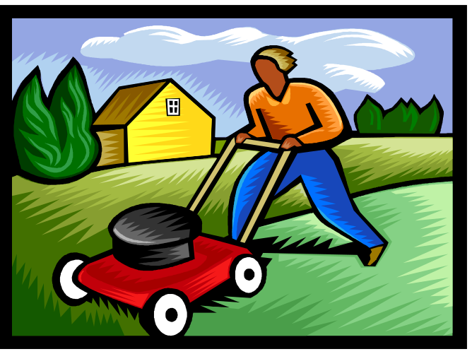
Physical Activity and Exercise
Physical activity is a general term that includes sports, dance, and activities done at work or at home, such as walking, climbing stairs, or mowing the lawn.
When people do physical activity especially for the purpose of getting fit, we say they are doing exercise.

Slide 5
Health and Wellness Benefits of Physical Activity
Regular physical activity can do much to prevent disease and illness.
It can help you look your best (with proper nutrition, good posture, and good body mechanics).
Besides looking better, people who do regular physical activity feel better, do better on academic work, and are less depressed than people who are less active.
Regular physical activity results in physical fitness which is the key to being able to do more of things you want to do and enjoy life.
It allows you to be fit enough to meet emergencies and day-to-day demanding situations.
Being physically active can build fitness, which, in turn, provides you with many health and wellness benefits.

Slide 6
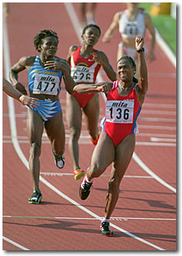
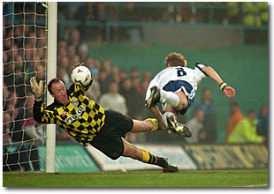
The Parts of Physical Fitness
Health - Related Physical Fitness
Skill - Related Physical Fitness
It helps you perform well in sports and activities that require certain skills
It helps you stay healthy

Slide 7
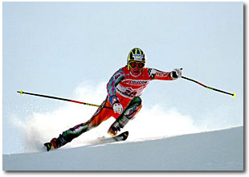
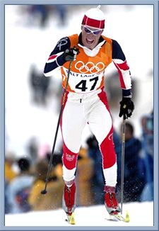

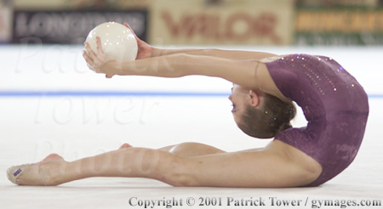

Health - Related Physical Fitness
Cardiovascular fitness: the ability to exercise your entire body for long periods of time.
Strength: the amount of force your muscles can produce.
Muscular endurance: the ability to use your muscles many times without tiring.
Flexibility: the ability to use your joints fully through a wide range of motion.
Body fatness – composition: is the percentage of body weight that is made up of fat when compared to other body tissue, such as bone and muscle.

Slide 8
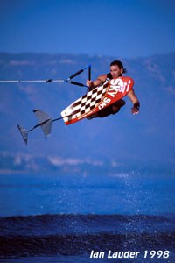
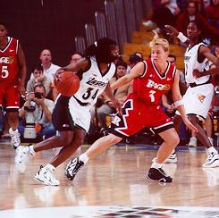
Skill - Related Physical Fitness
Different sports require different parts of skill -related fitness.
Many sports require several parts. For example, a skater might have good agility, but may not posses good power.
Some people have more natural ability in skill areas than others.
Good health does not come from being good in skill-related fitness.

Slide 9
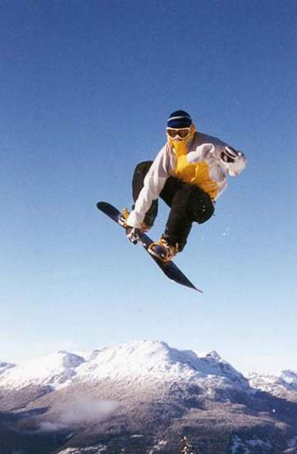
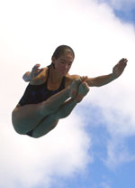
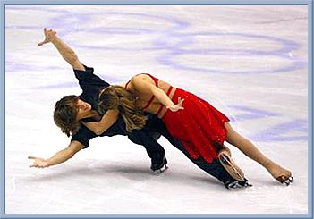
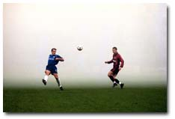
Agility
Agility is the ability to change the position of your body quickly and to control body’s movements. People with good agility are most likely to be good at activities such as: diving, soccer, ice skating, wrestling, etc.

Slide 10
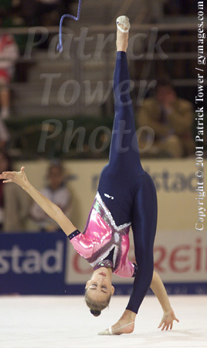
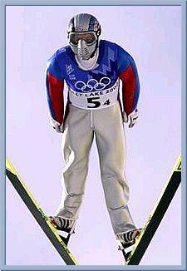
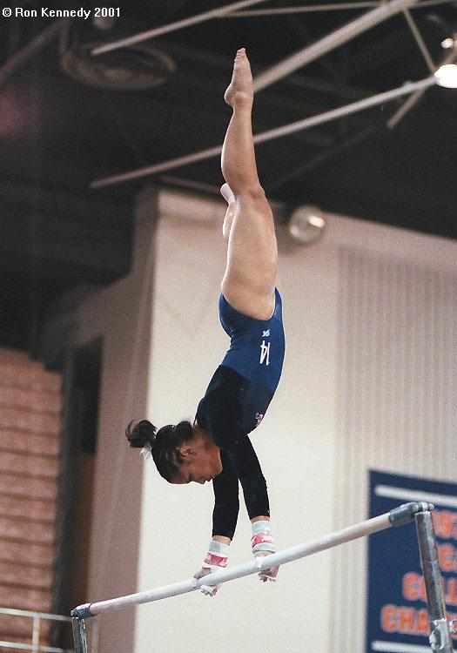
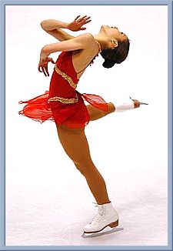
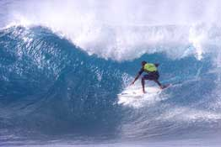
Balance
Balance is the ability to keep an upright posture while standing still or moving. People with good balance are most likely to be good in activities such as gymnastics, ice skating, rhythmic gymnastics, ski-jumping, surfing, etc.

Slide 11
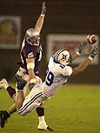
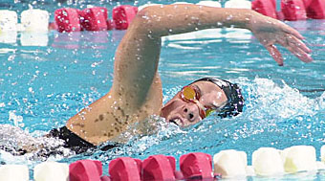
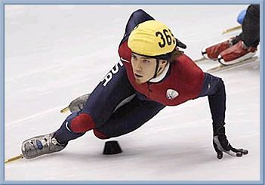
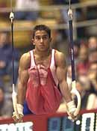
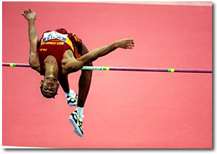
Power
Power is the ability to use strength and speed. People with good power might have the ability to put the shot, throw the discus, high jump, play football, speed swim, speed skate, etc.

Slide 12
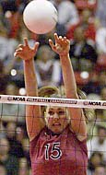
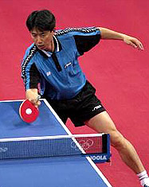
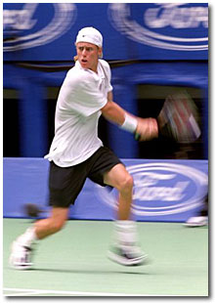
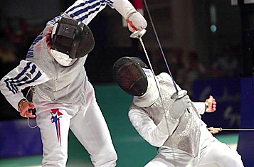
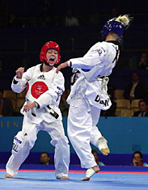
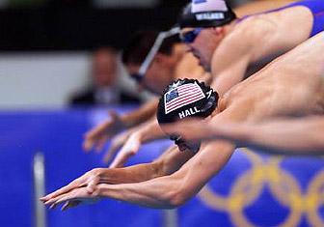
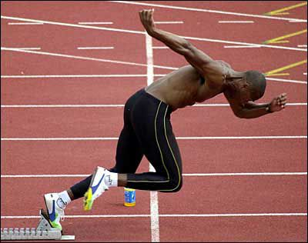
Reaction Time
Reaction time is the amount of time it takes to move once you realize the need to act. People with good reaction time are able to make fast starts in track or swimming, or to dodge a fast attack in fencing or karate.

Slide 13
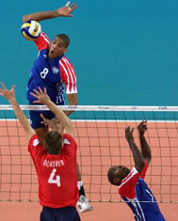
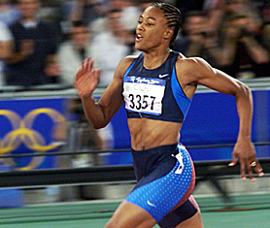
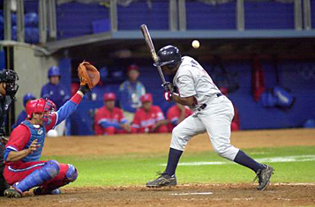
Speed
Speed is the ability to perform a movement or cover a distance in a short period of time. People with leg speed can run fast, while people with good arm speed can throw fast or hit a ball that is thrown fast.

Slide 14
Lifetime Fitness
Step 1: Doing Physical Activity
Step 2: Getting Fit
Step 3: Self-Assessment
Step 4: Self-Planning
Step 5: Lifetime Activity
Step 6: Lifetime Fitness

